Slide 1
Resolution Strategies (RS)
Office Hours
Dec 12, 2024
9:00 am - 10:00 am

Slide 2
Welcome
Guest Speakers
Ed Boyte, Founder of the Listening Group, RTFH Consultant
RTFH Team
Jan Walton, Regional Outreach Coordinator East/South
Vanessa Graziano, Community Partnership Liaison
Tyler Uhlig, HMIS Manager
Grants & Contract Team
Susan Kim, Grants & Contracts Manager
Ronniece Boston, Grants & Contracts Manager
Jess Torres, Program Analyst
Quanisha Spann, Program Specialist
Notes:
Welcome/Introductions
Housekeeping Items:
-Adding names and organizations they are with into the chat for recordkeeping.
Please use the chat for any questions, the team will answer as we go and if it cannot be answered, RTFH will post a FAQ or respond via email.

Slide 3
Agenda
RS Spending (Snapshot)
RS Future & Transition
Updates, Referrals, Close-Out
RS Connection & Creativity
Q&As
Reminders & Resources
01
03

Slide 4
RS YTD
Financial & Outcomes
Snapshot
1/1/24 thru 11/30/24
Notes:
Include a chart showing amount YTD and clients served

Slide 5
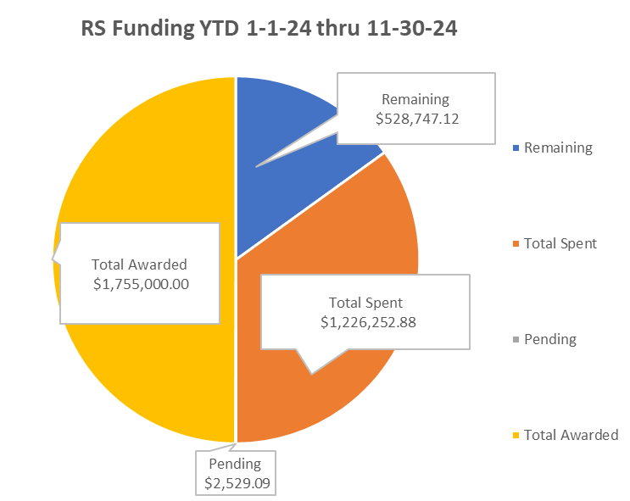
01
Notes:
RTFH has increased RS providers to spend the philanthropic dollars.
We will have this updated every month so providers can see where we are as a whole on RS funding and to give you enough notice if we need to scale back on spending.
Total Awarded $ 1,755,000.00
Total Processed: $1,226,252.88
Pending Approval: $2,529.09
Remaining balance $ 526,218.03

Slide 6
Households Served
Households Served 400
Out of the total amount, 30 clients are youth, 93 seniors, and 260 adults
Household composition: 153 families and 238 individuals, 9 Unknown have been helped
Highest expenses submitted Deposit/Rental Assistance and Interim Hotel
01
Notes:
RTFH has increased RS providers to spend the philanthropic dollars.
We will have this updated every month so providers can see where we are as a whole on RS funding and to give you enough notice if we need to scale back on spending.
Total Awarded $ 1,755,000.00
Total Processed: $1,226,252.88
Pending Approval: $2,529.09
Remaining balance $ 526,218.03

Slide 7
RS Future Funding
&
Transition
Notes:
The future of RS Funding and the transition process, including referrals

Slide 8
RS Updates
2025 Changes
RTFH will continue funding subrecipients who currently have Diversion-focused Outreach contracts thru 12/31/25.
RTFH will no longer reimburse ineligible activities or clients as funding is limited.
HMIS RS Program and Billing Update (Currently finishing pilot project).
Technical Assistance (TA)
If subrecipients/providers would like specific TA or meetings with Ed Boyte, please contact your RTFH G&C Manager or grants@rtfhsd.org
Notes:
Providers who will no longer have access to RS funds should have already received a letter from RTFH. If you have any questions after this meeting, please reach out to your G&C Manager.
RS funds limitation explanation.
We will have this updated every month so providers can see where we are as a whole on RS funding and to give you enough notice if we need to scale back on spending.
Remaining balance $931,681.76
Clients Served 140
Households Served 139
Out of the total amount, 10 clients are youth, 30 seniors, and the rest are adults (100)
Highest expenses Deposit/Rental Assistance and Vehicle Repair

Slide 9
RS Referral Process
This process is for non funded (RS) providers.
Referring Agency’s Diversion Trained Staff must ensure clients are eligible under the RS P&Ps.
Send RTFH the HMIS ID and request for financial assistance for a potential RS Match to diversion@rtfhsd.org
All documents will be uploaded to HMIS for review.
RTFH will review requests (within 3 business days) and match to an agency with RS funds.
Matches will be made based on client location and availability of funds.
Must submit and keep up to date the RS Referral POC Form to receive referrals.
Respond within 1 business days
RS funded subrecipient will process the financial request and submit the invoice to RTFH for reimbursement.
HMIS Data entry to be completed to capture the enrollments, exit destinations, financial assistance, and other contractual outcomes
Referring Provider
(No RS Funds)
RTFH
(Matchers)
RS Subrecipient
(RS $ & Matched)
Notes:
This is referral process is not open to all providers in the community only to those who had RS funding in 2024 and will not have it in 2025.
Update on RTFH to come
Need from RS providers: Dependable POC for RS matches (within 1 business day).
Temporary solution for referring providers until referrals are good.

Slide 10
Close Out
Invoice
12/15/24 Invoices Due
Please submit all expenses for reimbursement including all documentation and general ledger (GL).
HMIS
Make sure all the data entered is clean and data quality is up to date.
If you’re not getting RS funding for next year, notify the HMIS team
Final
Final invoices are due 1/15/25 - RTFH will not take any invoices later than the 15th.
Final report submission 1/30/25 - covering the entire grant term.
RTFH will send out a close out letter once all invoices have been processed
Notes:
Need to talk about: there will not be anymore RS office hours….at least right now.

Slide 11
RS Connection
&
Creativity
Notes:
The future of RS Funding and the transition process, including referrals

Slide 12
Diversion and RS Funding – Connection & Creativity
Uncertain funding is the norm
Focuses our attention on CLIENT ENGAGEMENT and CREATIVITY
RS, diversion flex funding:
Should be seen as the last step
A tool to assist clients with their own housing plan
With the funding the client will be housed,
Without it they will remain unhoused, and
Funds are not available elsewhere

Slide 13
Diversion and RS Funding – Connection
The key to Trauma Informed Care and
Creative solutions are usually only possible if we connect and partner
Empathy – connection
Demonstrating that they are valued and that we care
Active Listening
body language, eye contact and paraphrasing
Empathy
Statement of empathy “you seem frustrated”
Validating – acknowledging their experience, and
Normalizing – helping them not feel alone in an experience, “many people are scared to be in your situation as well”

Slide 14
Fully Understanding their Story
In addition to the connection, fully understanding their experience, including
Their previous and current income
What their most successful housing has looked like
Allows us to understand what their next, safer and more permanent housing options may be
Generally where and how they have lived before is most similar to where they may live next
In diversion, it's rare to pay first month’s rent and deposit for someone who doesn’t have a strong rental history and income

Slide 15
Diversion and RS Funding – Creativity
After we have connected and understood their journey,
Then we can begin to partner with them
Exploring options and resources they may have forgotten or dismissed:
Skills
Interests
People they may have lived with or otherwise supported them
Shared housing option
Employment
Interim Housing as we work with them on longer-term options

Slide 16
Diversion and RS Funding – Creativity
How can your team creativity use diversion?
What are the unique aspects of your program, or
Of those you work with?
Clients without strong rental history and income will need creative support and partnership to get and maintain permanent housing
Let’s look at how the Alpha Project, as an example

Slide 17
Diversion Practice – Alpha Project
Clientele – not recently evicted or have strong rental history
Many qualify as chronically homeless
On-going staff support and training, weekly:
Mini-trainings that reinforce the steps and values of diversion
Case conferencing
Office hours on finding units and property owner engagement
Genuine client engagement and support exploration
Dedicated diversion team
Connection to employment prior to housing
Use of SRO – steps by step, mini-wins
30% housed were chronically homeless

Slide 18
01
Questions?
03
Notes:
Request that they submit their email addresses if they didn’t receive the invite for the office hours. (include this)

Slide 19
Resources
Grants & Contracts
HMIS
Diversion
01
Financial Questions
grants@rtfhsd.org
Expenditure Sheet: click here
RS P&P – click here
Invoice Steps: click here
Data/Reporting Questions
support@rtfhsd.org
Programmatic Questions
Training: taskforce@rtfhsd.org
Practices:BoyteEdwardL@gmail.com
Diversion 101 – click here
All resources and documents can be found on the RTFH’s website: https://www.rtfhsd.org/funding/grant-recipients/
Notes:
Put

